Slide 1
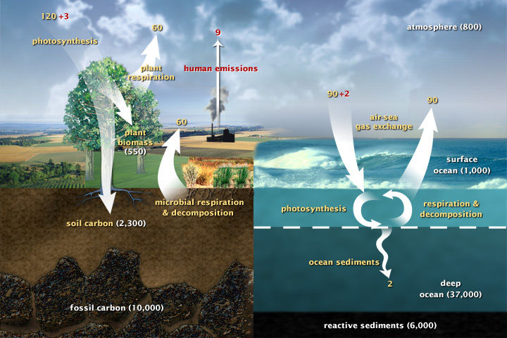
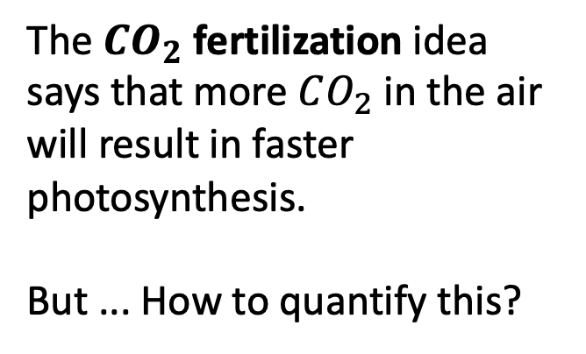
Carbon fluxes in Earth’s climate system
The $CO_{2}$ fertilization idea says that more $CO_{2}$ in the air will result in faster photosynthesis.
But ... How to quantify this?
(377 ppm)

Slide 2
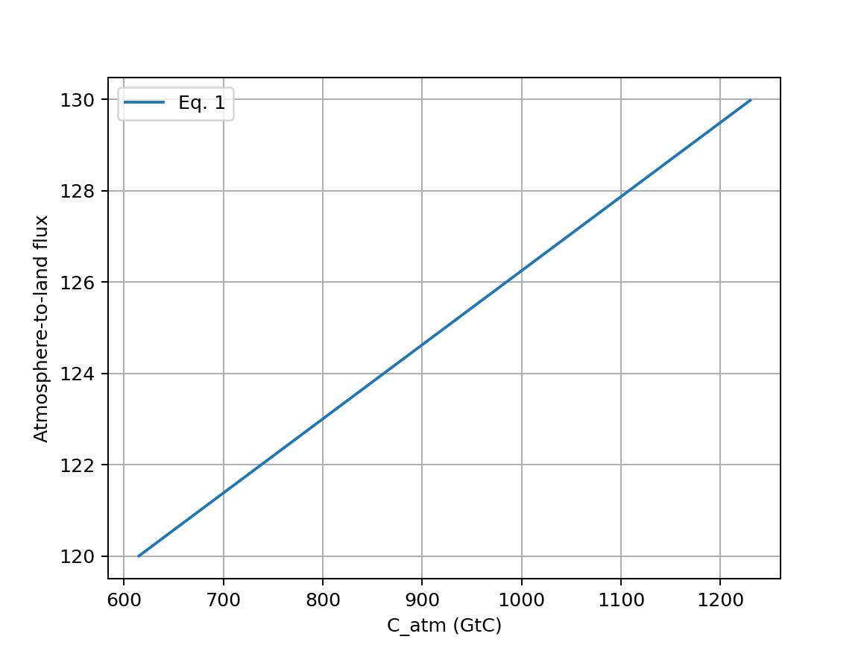



$CO_{2}$ fertilization in mathematical form
In 2024 ($425 ppm$)
In 2003 ($377 ppm$)
pre-industrial atmospheric $CO_{2}$ ($290 ppm$)

Slide 3
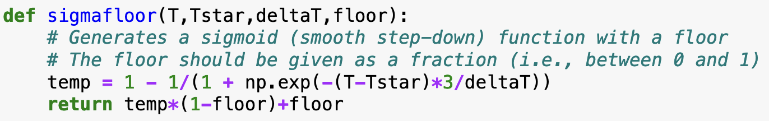
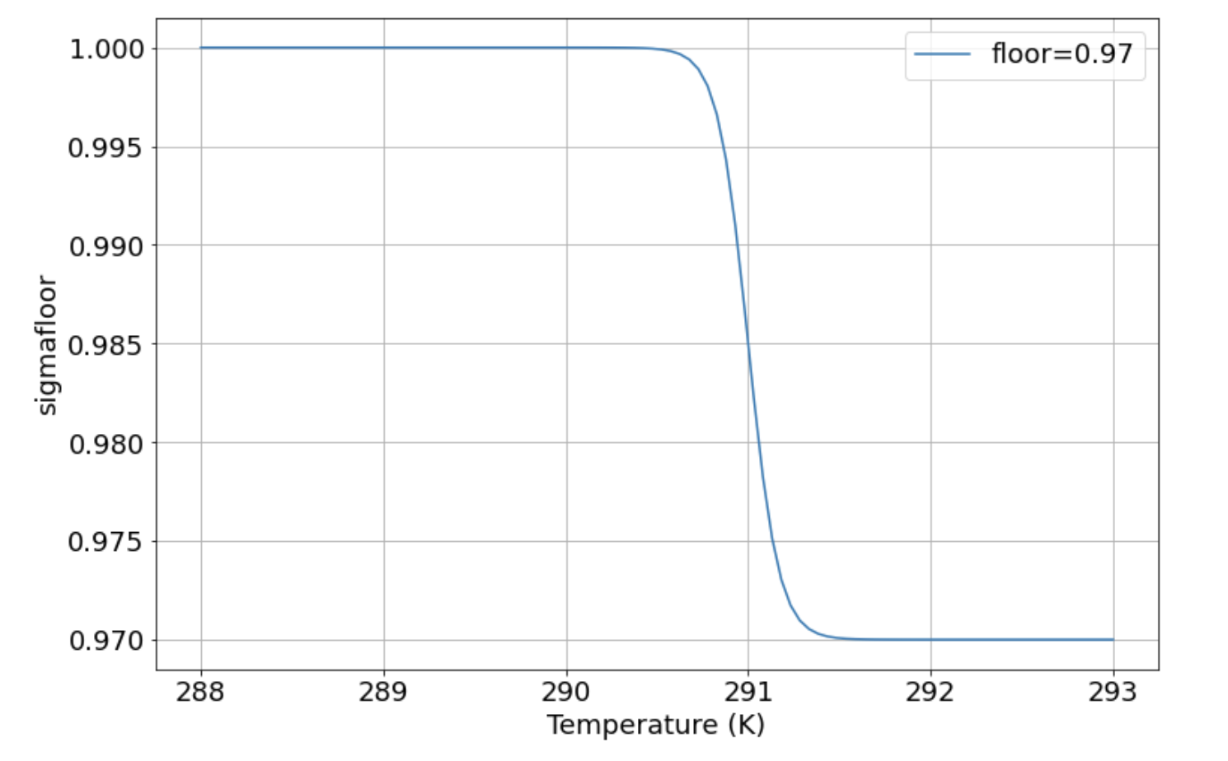
To implement temperature-dependent $CO_{2}$ fertilization, we’ll need a sigmoid function
Our sigmoid function transitions from a value of 1, to a lower value when the temperature crosses a threshold value.
The variable “T” is the array of temperatures on the x-axis. The variable “Tstar” determines the temperature of the transition.

Slide 4
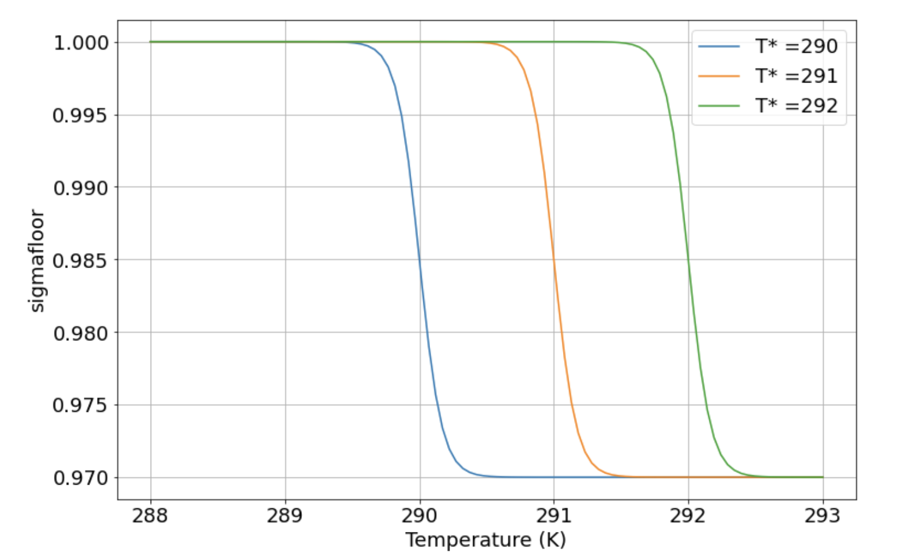
To implement temperature-dependent $CO_{2}$ fertilization, we’ll need a sigmoid function
Here’s the effect of other values of “Tstar”

Slide 5
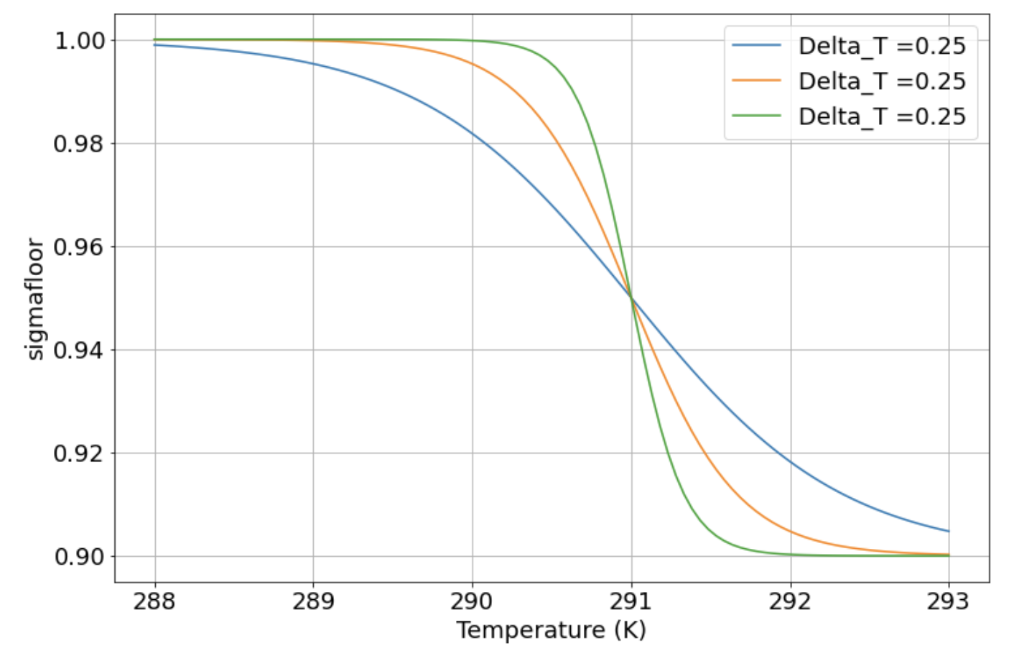
To implement temperature-dependent $CO_{2}$ fertilization, we’ll need a sigmoid function
Here’s the effect of different values of “deltaT” (also referred to as “T_transition” in the Notebook)

Slide 6
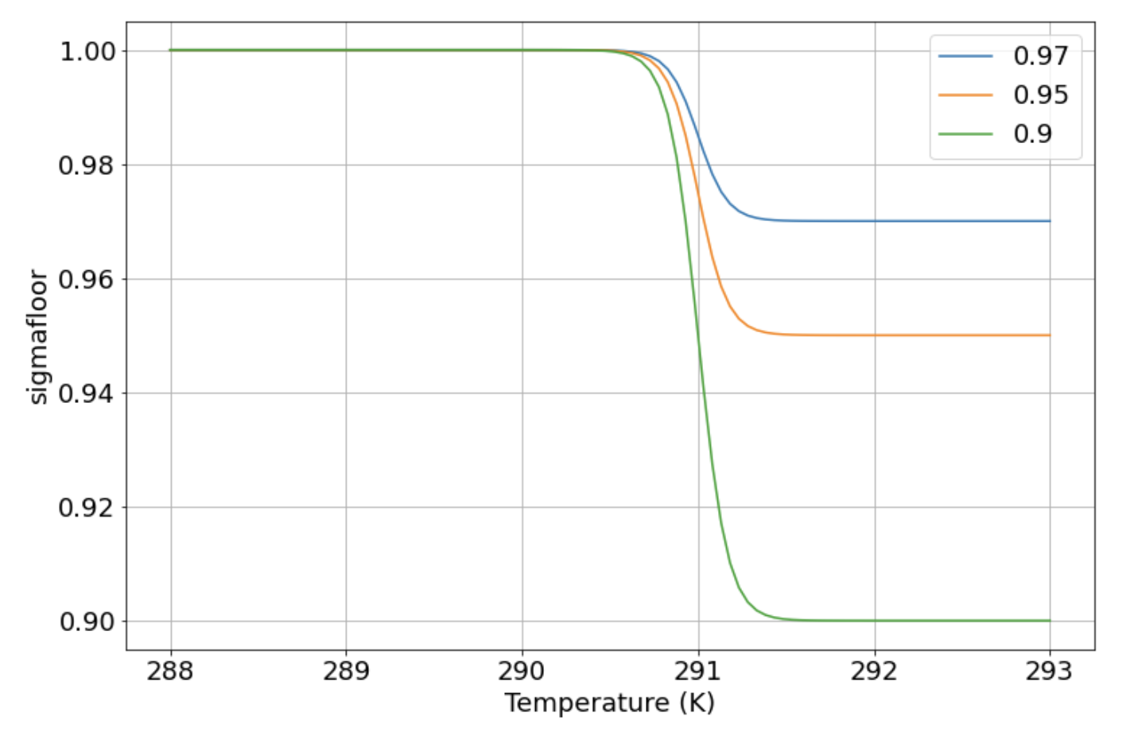
To implement temperature-dependent $CO_{2}$ fertilization, we’ll need a sigmoid function
Here’s the effect of different values of “floor”

Slide 7
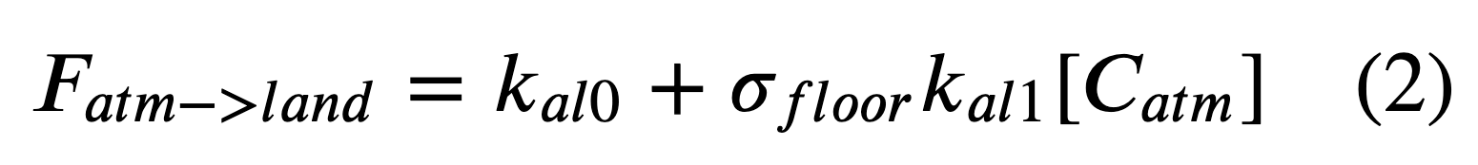
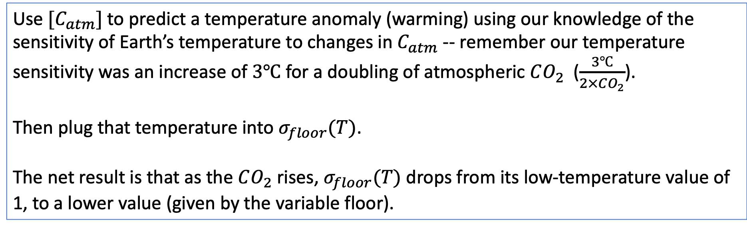
Using $σ_{floor}(T)$ to implement temperature-dependent $CO_{2}$fertilization
Use $[C_{atm}]$ to predict a temperature anomaly (warming) using our knowledge of the sensitivity of Earth’s temperature to changes in $C_{atm}$ -- remember our temperature sensitivity was an increase of $3℃$ for a doubling of atmospheric $CO_{2}$ ($\frac{3℃}{2×CO_{2}}$).
Then plug that temperature into $σ_{floor}(T)$.
The net result is that as the $CO_{2}$ rises, $σ_{floor}(T)$ drops from its low-temperature value of 1, to a lower value (given by the variable floor).

Slide 8
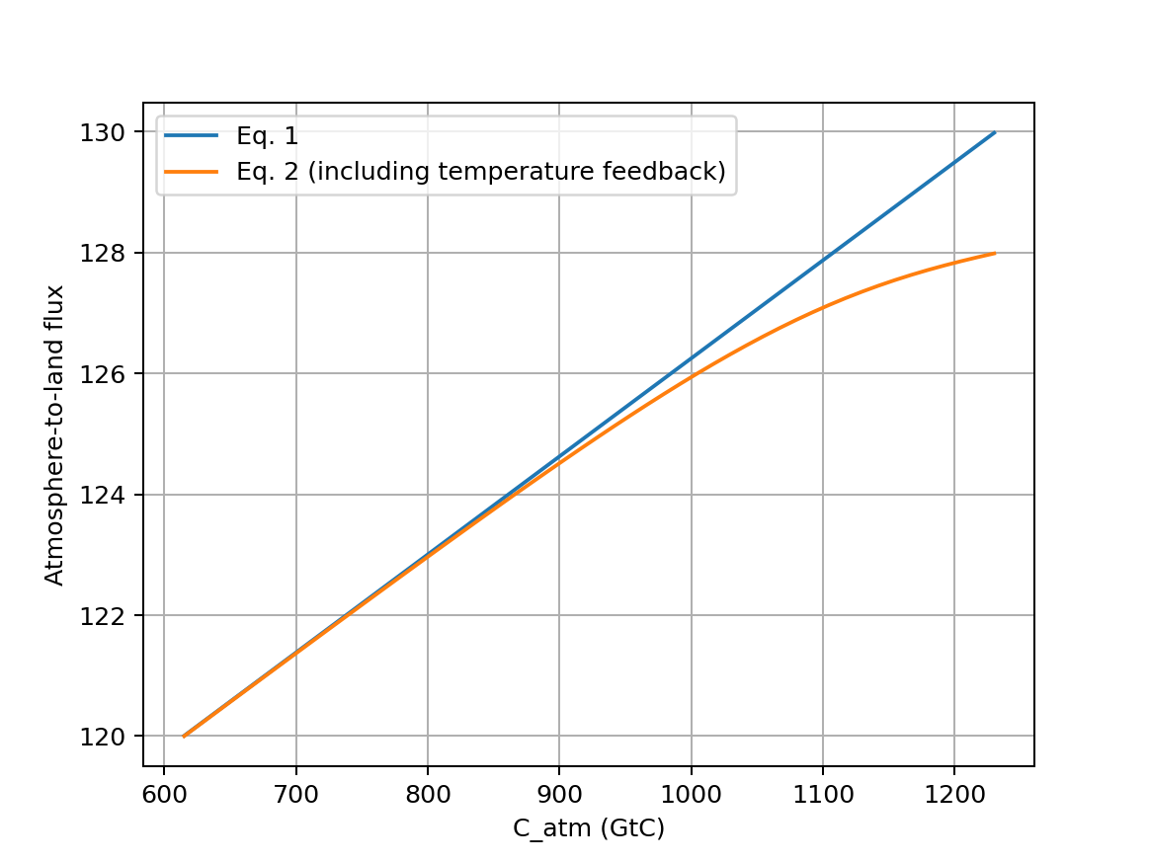
Using $σ_{floor}(T)$ to implement temperature-dependent $CO_{2}$fertilization
In 2024 ($425 ppm$)
In 2003 ($377 ppm$)
pre-industrial atmospheric $CO_{2}$ ($290 ppm$)

Slide 9
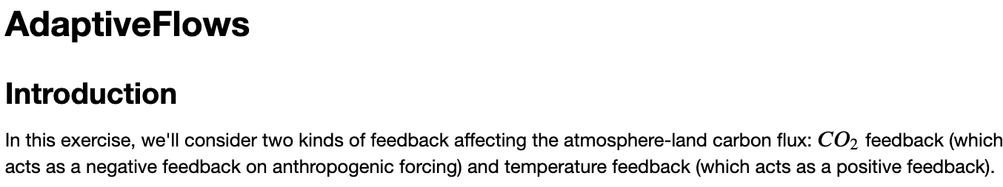
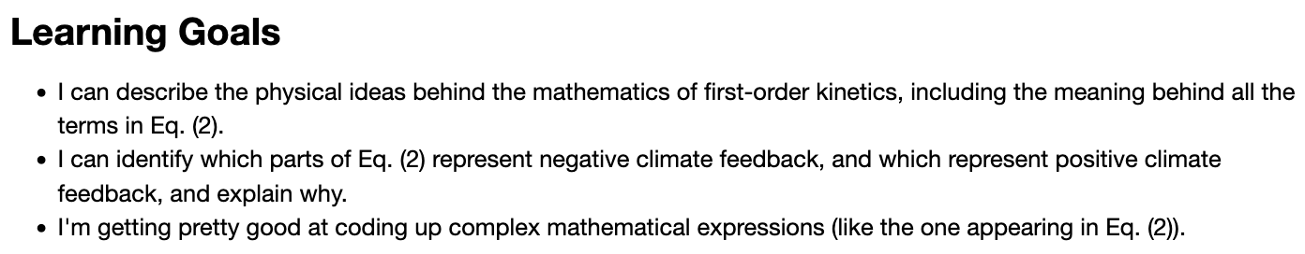
OK, let’s get started
Notes:
Predict the temperature if CO2 continues to rise. If we reduce CO2 emissions to zero.

